Slide 1
Lab 5 & 6 (mini project)
Taghreed Alanazi

Slide 2
Check Mini-project Description.pdf for the instructions.

Slide 3
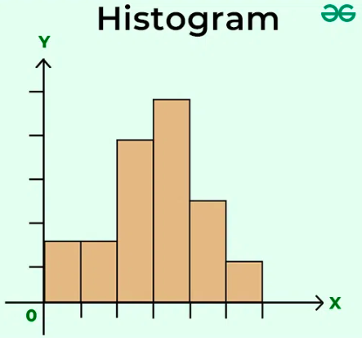
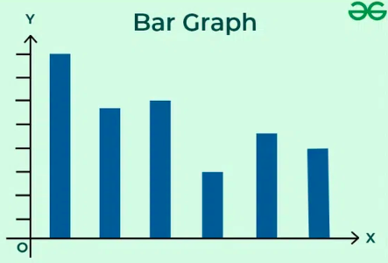
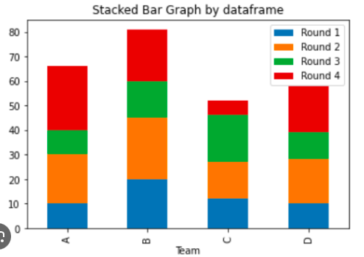
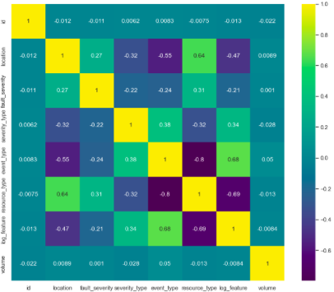
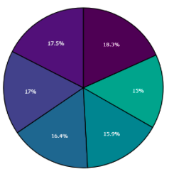
Graphs used in the previous labs:
Histogram: ‘Frequency distribution of a variable’. A graphical representation of the distribution of a dataset.
Bar graph: A chart that represents data with rectangular bars with heights proportional to the values they represent.
Stacked bar plot: Conditional distribution. Each bar represents a total, and segments in the bar represent different parts or categories of that total.
Heatmaps: Can be used for showing correlation between two variables, joint distributions.
pie plots: Illustrate numerical proportions.

Slide 4
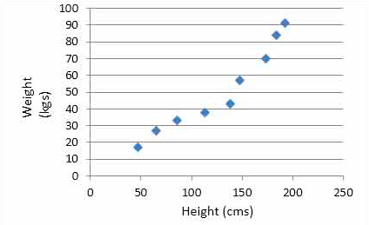
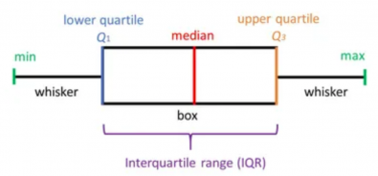
We will cover some new graphs!
Scatter plot:
To observe and show relationships between two numeric variables.
Helpful in identification of the correlation relationships.
Boxplot:
Can display the distribution of a variable based on the five-number summary: the minimum, the maximum, the sample median, and the first and third quartiles.
Median (Q2/50th Percentile): the middle-point of the ordered data.
First quartile (Q1/25th Percentile): the middle-point from the minimum to the median. 25% data fall below this value.
Third quartile (Q3/75th Percentile): the middle-point from the median to the maximum. 75% data fall below this value.
Interquartile range (IQR): Q3 - Q1.
Maximum and Minimum
The outlier: the data point larger than Q3+1.5IQR, or smaller than Q1-1.5IQR.
Boxplot can also identify the outliners of a dataset.
0 5 9

Slide 5
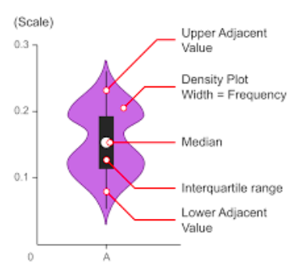
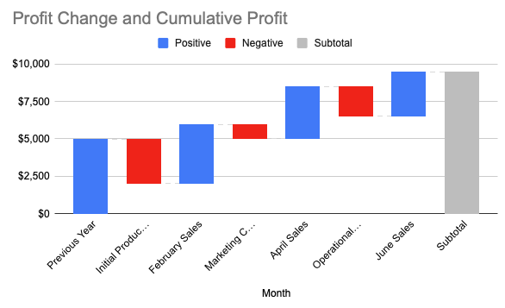
Violin plot
Very similar to the boxplot, it provides a visualization of the distribution of the data, its probability density, and its cumulative distribution.
Density Estimation: The wide sections of the violin plot represent areas where the data is more concentrated (i.e., a higher density of data points), and the narrow sections represent areas where the data is less concentrated.
Box Plot Inside: Often, a violin plot will have a mini box plot inside, showing the median (a horizontal line) and the interquartile range (the width of the box).
Waterfall chart
show how a starting value of something (say, a beginning monthly balance in a checking account) becomes a final value (such as the balance in the account at the end of the month) through a series of intermediate additions and subtractions.

Slide 6
Go through lab 5 & 6 examples!

